Slide 1

M001CRB: Workshop 4
Managers as effective leaders: contribution to creating and communicating the organisation

Slide 2
By the end of this workshop you should be able to:
Describe why communication is important to leaders and managers
Outline different methods of communication and how these may be used
Consider what makes some communication poor or excellent
Formulate strategies for communicating effectively to stakeholders
Evaluate how different forms of communication may include or exclude groups or individuals.

Slide 3
Overview of Workshop 4
Part 1:
Recap from Workshop 3 & Learning Journey 4
Communication activities
Part 2:
Communication
Ways of communicating - what works for you and what doesn’t
Part 3:
Introducing Learning Journey 5
Assignment guidance and Module evaluation
Please note that the MEQ will occur during this workshop

Slide 4
CLIENT
CLARITY
CREATE
CHANGE
CONFIRM
CONTINUE
CLOSE
WORKSHOP 1:
Analyse client Needs
Organisational Strategy
WORKSHOP 2:
Leadership Styles
Culture, values, legal, ethical environment
WORKSHOP 3:
Creative Thinking
WORKSHOP 4:
Managers as Effective Leaders
Communication Tools
WORKSHOP 1: Key Concepts
The role of the consultant
Assessing clients’ needs
Strategic position
Performance management
WORKSHOP 2: Key concepts
Leaders vs Managers
Transformational, transactional and situational leadership styles
impact on organisational strategy
Creation of the organisation’s vision, mission and values
Influence of legal, ethical and social values on leadership
WORKSHOP 3: Key Concepts
Tools and techniques for creative thinking;
Brainstorming
Six thinking hats
Managing Uncertainty
Reflective practice
WORKSHOP 4: Key concepts
Good and poor Communication examples
Ways of communication - VARK
Communication with Stakeholders
Learning Journey 1 –Preparation Material for Workshop 1:
Role of the consultant
The 7 Cs of consulting
Strategy
Learning journey 2 - End of Workshop 1 Information and Preparation Material for Workshop 2:
STRATEGY
What is strategy?
Strategic positioning
Tools & techniques for assessing client needs
Benchmarking
Performance management
Preparation for workshop 2
Learning journey 3 - End of Workshop 2 Information and Preparation Material for Workshop 3:
LEADERSHIP
Understanding management & leadership styles
Leadership videos
Leading for an unpredictable future
Preparation for workshop 3
Learning journey 4 - End of Workshop 3 Information and Preparation Material for Workshop 4:
LEADERS AS CHANGE AGENTS
The 7 Cs of consulting
Linking theory and practice
How to get out of the box video
Creativity & leadership
Preparation for workshop 4
Learning journey 5 - End of Workshop 4 Information
COMMUNICATION & CONSOLIDATION
Communication checklist
Communicating across cultures
Good communication tools and tips
Assessment guidance

Slide 5
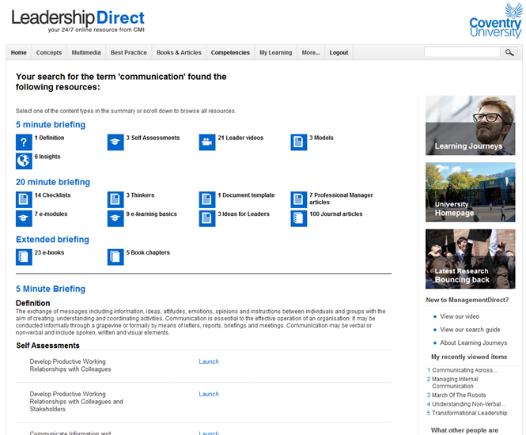
Resources to support this Workshop...
...can be found on the CMI LeadershipDirect web pages.
Search for ‘Communication’ in the search box
Review Workshop 4 materials
See additional resources at the end of these slides.

Slide 6
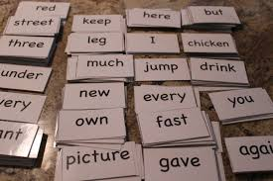

Communicate this - exercise
Taking turns pick a card and communicate the word to your teammates without speaking or writing the word down.
How many words can you communicate in 5 minutes?
Discussion:
What worked well?
What didn’t work so well?

Slide 7
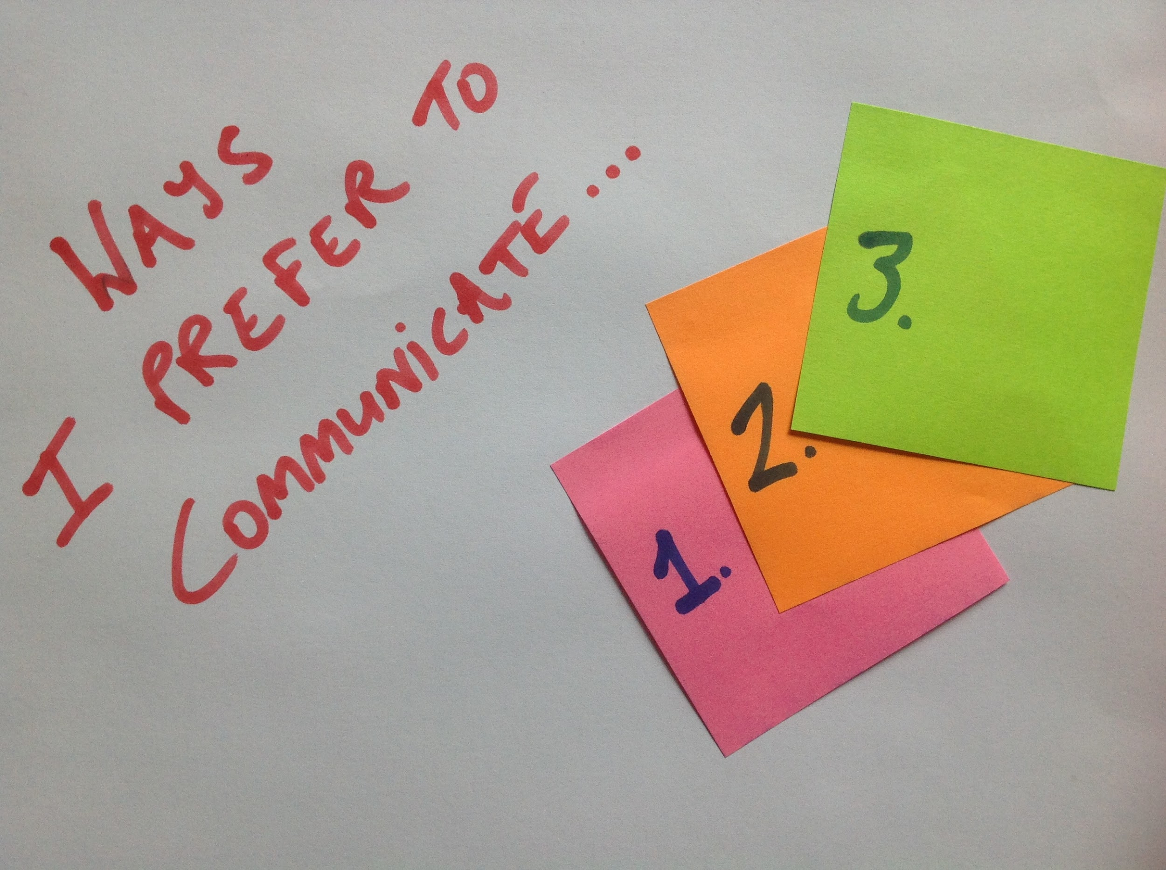
Communication & you

Slide 8
Mehrabian. (1967)
Non Verbal Communication. - approx 55%
Intonation / Inflection - approx 35%
Words spoken - approx 10%
Source:
https://www.bl.uk/people/albert-mehrabian
See also:
Conference paper: Decoding Non-Verbal Communication” in Second International Seminar on “Teaching and learning of ESL in Technical Education – Overcoming the Odds. January 2011
Vipin Sharma
Notes:
See paper as below for critique
January 2011
Conference: Decoding Non-Verbal Communication” in Second International Seminar on “Teaching and learning of ESL in Technical Education – Overcoming the Odds
K Vipin
Vipin Sharma
See also
https://www.bl.uk/people/albert-mehrabian

Slide 9
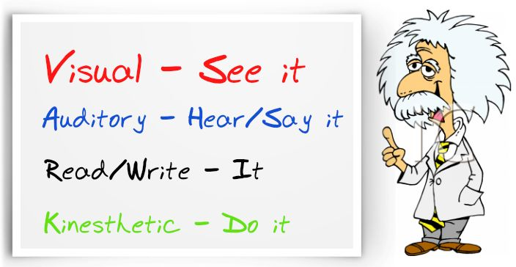
Communication preferences

Slide 10
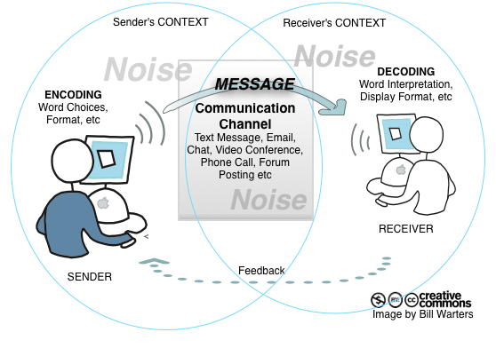
Adapted from Shannon and Weaver (1949)

Slide 11
Communication and Leadership
Kettley and Strebler (1997) identified the following key soft skills for leadership:
Gaining trust
Developing people
Encouraging and empowering others
Nurturing effective relationships
Communicating and influencing
Working with new information, concepts and strategies
Managing themselves effectively
Seeking and using feedback
Tenacity and integrity
Notes:
Kettley P. and Strebler M. (1997) ‘Changing Roles for Senior Managers’ IES Report 327

Slide 12
Communication and Strategy
Discussion Groups
You are a new CEO for one of the following:
Royal Shakespeare Company Stratford
Airbus
Marks and Spencer PLC
University Hospital Coventry
Define your new vision for the company and set out your plan to communicate this
(based on Kettley and Strebler slide)
15 minute discussion. - 15 minute debrief

Slide 13
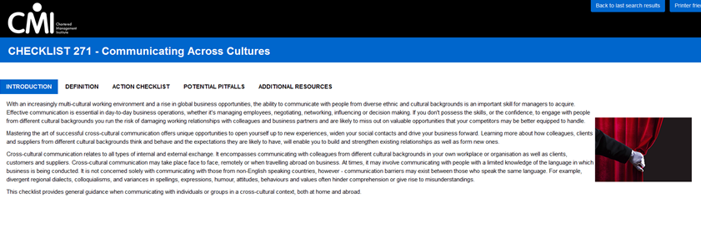
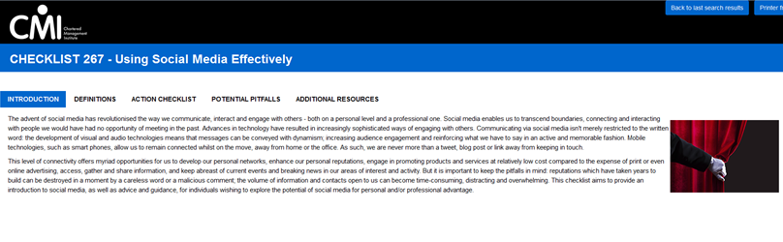
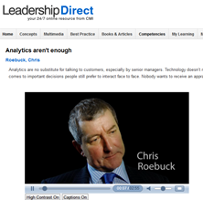
Ways of communicating - resources
Useful resources to review on LeadershipDirect:
From Learning Journey 5 ‘Communicating across cultures’ and
‘Using social media effectively’
Consider the role of communication in previous workshops and learning journeys, particularly transformational leadership (and charismatic leadership).
Watch ‘Analytics aren’t enough’ video.

Slide 14
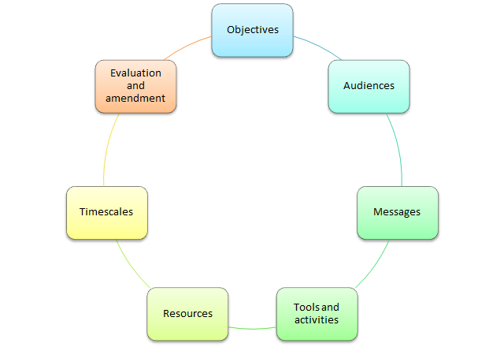
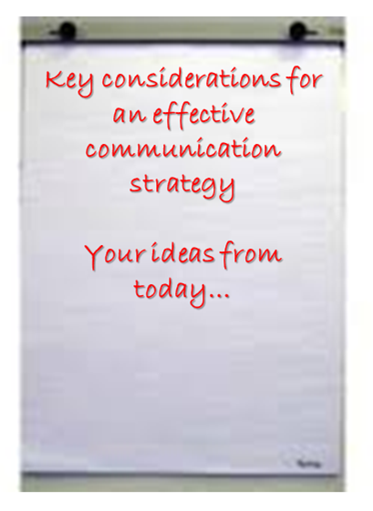
Ways of communicating - summary
What do you think are the key considerations in developing an effective communication strategy?
How will this be useful for the company you have chosen?
Useful framework? Source: https://www.odi.org/publications/5186-planning-tools-how-write-communications-strategy

Slide 15
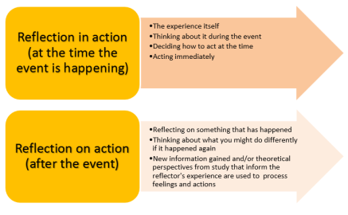
Review of workshop outcomes
Communication is vitally important to leaders and managers
The value of VARK in designing communication strategies
Examples of good and poor communication
Designing strategies for communicating effectively to stakeholders
Impact of communication strategies and how they may include or exclude groups or individuals
Schön (1983)

Slide 16

CLIENT
CLARITY
CREATE
CHANGE
CONFIRM
CONTINUE
CLOSE
WORKSHOP 1:
Analyse client Needs
Organisational Strategy
WORKSHOP 2:
Leadership Styles
Culture, values, legal, ethical environment
WORKSHOP 3:
Creative Thinking
WORKSHOP 4:
Managers as Effective Leaders
Communication Tools
WORKSHOP 1: Key Concepts
The role of the consultant
Assessing clients’ needs
Strategic position
Performance management
WORKSHOP 2: Key concepts
Leaders vs Managers
Transformational, transactional and situational leadership styles
impact on organisational strategy
Creation of the organisation’s vision, mission and values
Influence of legal, ethical and social values on leadership
WORKSHOP 3: Key Concepts
Tools and techniques for creative thinking;
Brainstorming
Six thinking hats
Managing Uncertainty
Reflective practice
WORKSHOP 4: Key concepts
Good and poor Communication examples
Ways of communication - VARK
Communication with Stakeholders
Learning Journey 1 –Preparation Material for Workshop 1:
Role of the consultant
The 7 Cs of consulting
Strategy
Learning journey 2 - End of Workshop 1 Information and Preparation Material for Workshop 2:
STRATEGY
What is strategy?
Strategic positioning
Tools & techniques for assessing client needs
Benchmarking
Performance management
Preparation for workshop 2
Learning journey 3 - End of Workshop 2 Information and Preparation Material for Workshop 3:
LEADERSHIP
Understanding management & leadership styles
Leadership videos
Leading for an unpredictable future
Preparation for workshop 3
Learning journey 4 - End of Workshop 3 Information and Preparation Material for Workshop 4:
LEADERS AS CHANGE AGENTS
The 7 Cs of consulting
Linking theory and practice
How to get out of the box video
Creativity & leadership
Preparation for workshop 4
Learning journey 5 - End of Workshop 4 Information
COMMUNICATION & CONSOLIDATION
Communication checklist
Communicating across cultures
Good communication tools and tips
Assessment guidance

Slide 17
Communication - Employer scenarios
Watch the video extract (13.00-14.30) for Richard Welford – Independent Consultant from Evolve SBC talking about communication and management in TATA
As a consultant how could you help TATA to communicate its message about its management decisions more effectively to its key stakeholders?

Slide 18
ASSIGNMENT REVIEW

Slide 19

Assignment guidance - Q&A (allow 1 hour )
Let’s review the Assignment Brief and Guidance...
Questions?
Don't forget to mention the Support sessions

Slide 20

… and finally
Thank you
And best of luck with your assignment!
… from the M001CRB Team

Slide 21
CMI Resources
Links to CMI LeadershipDirect Resources:
http://mde.managers.org.uk/temp_access/content.aspx?id=79854 – Understanding management and leadership styles - Checklist
http://mde.managers.org.uk/temp_access/content.aspx?id=80965 – Communicating across cultures – Checklist
http://mde.managers.org.uk/temp_access/content.aspx?id=1094178 – Effective verbal communication with groups – Checklist
http://web.a.ebscohost.com/ehost/pdfviewer/pdfviewer?sid=70e7b68c-ce5c-4803-b140-4b5111a5fe26%40sessionmgr4003&vid=0&hid=4207 – Strategic leadership – The essential skills – Article
http://lib.myilibrary.com/Open.aspx?id=289758 – Strategic leadership – Online book
http://lib.myilibrary.com/Open.aspx?id=697729 – Strategic management – Online book
http://mde.managers.org.uk/temp_access/svideoplayback.aspx?id=81512&Digest=hUaVbc4p5dadT4kXdjqNqg – Importance of good communication – Short video
http://mde.managers.org.uk/temp_access/svideoplayback.aspx?id=81843&Digest=2um/Ly/J7MuSDiMdOVud8A - Effective leadership - A process of continuous self-improvement – Short video
Schön, D. A. (1983) The reflective practitioner: how professionals think in action. New York: Basic Books
‘How to use pictures, charts & graphics to make your message stick’
‘Communicating across cultures’
‘Using social media effectively’
‘Analytics aren’t enough’

Slide 22
CMI Resources
Links to CMI LeadershipDirect Resources:
http://mde.managers.org.uk/temp_access/content.aspx?id=79854 – Understanding management and leadership styles - Checklist
http://mde.managers.org.uk/temp_access/content.aspx?id=80965 – Communicating across cultures – Checklist
http://mde.managers.org.uk/temp_access/content.aspx?id=1094178 – Effective verbal communication with groups – Checklist
http://web.a.ebscohost.com/ehost/pdfviewer/pdfviewer?sid=70e7b68c-ce5c-4803-b140-4b5111a5fe26%40sessionmgr4003&vid=0&hid=4207 – Strategic leadership – The essential skills – Article
http://lib.myilibrary.com/Open.aspx?id=289758 – Strategic leadership – Online book
http://lib.myilibrary.com/Open.aspx?id=697729 – Strategic management – Online book
http://mde.managers.org.uk/temp_access/svideoplayback.aspx?id=81512&Digest=hUaVbc4p5dadT4kXdjqNqg – Importance of good communication – Short video
http://mde.managers.org.uk/temp_access/svideoplayback.aspx?id=81843&Digest=2um/Ly/J7MuSDiMdOVud8A - Effective leadership - A process of continuous self-improvement – Short video
Schön, D. A. (1983) The reflective practitioner: how professionals think in action. New York: Basic Books
‘How to use pictures, charts & graphics to make your message stick’
‘Communicating across cultures’
‘Using social media effectively’
‘Analytics aren’t enough’

Slide 23
CMI Resources
https://www.bl.uk/people/albert-mehrabian
See also:
Conference paper: Decoding Non-Verbal Communication” in Second International Seminar on “Teaching and learning of ESL in Technical Education – Overcoming the Odds. January 2011Vipin Sharma
Kettley P. and Strebler M. (1997) ‘Changing Roles for Senior Managers’ IES Report 327

